Slide 1
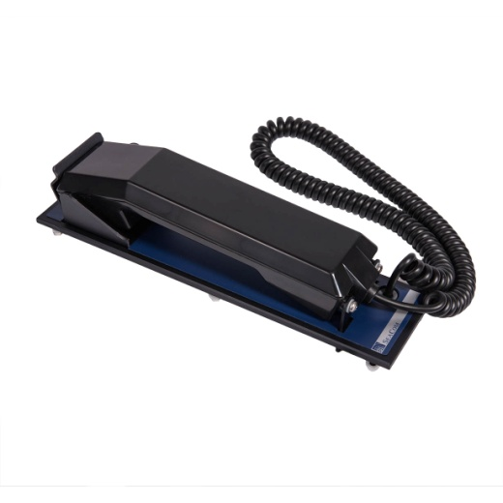
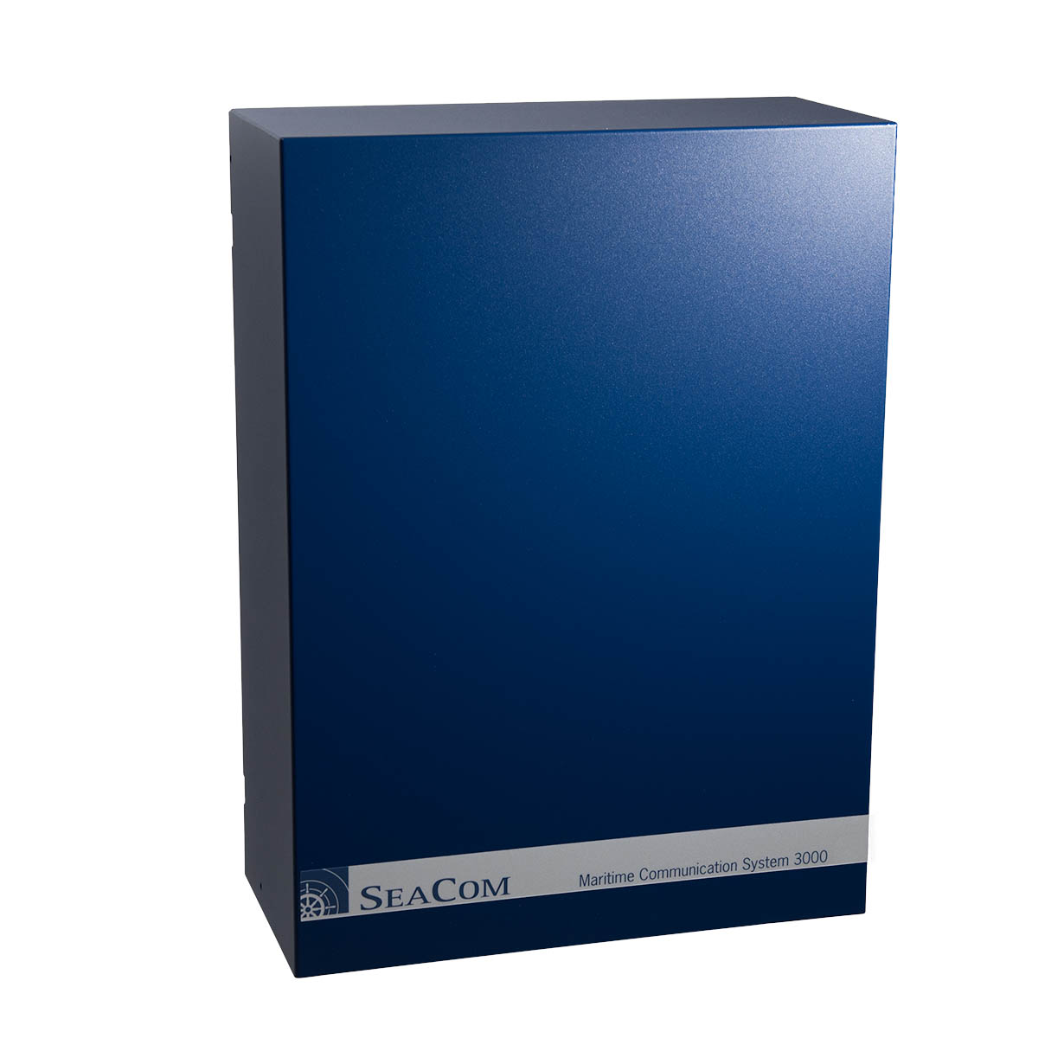
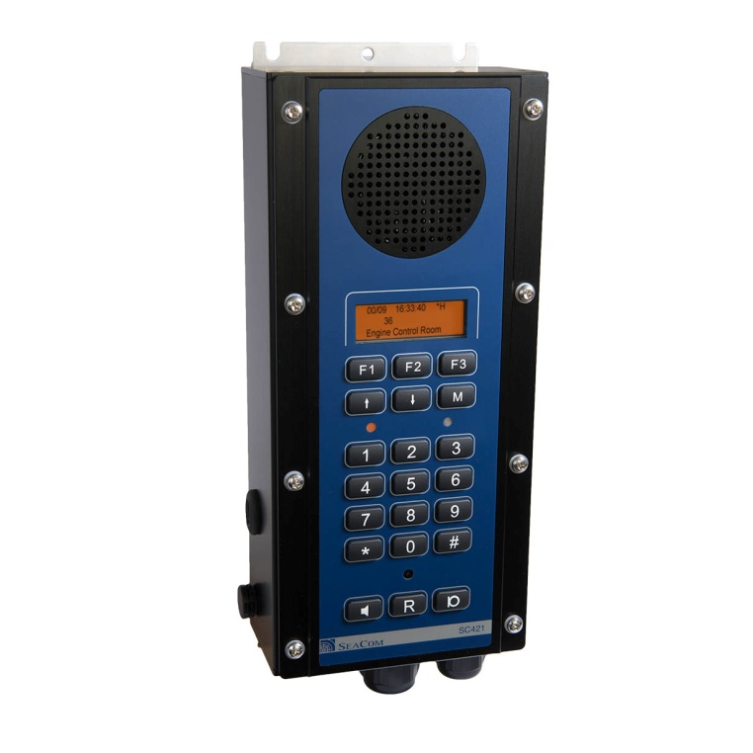
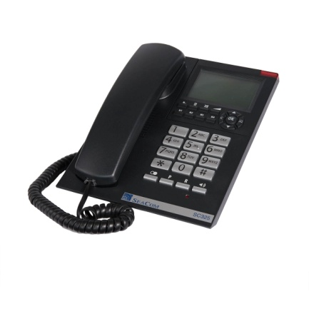
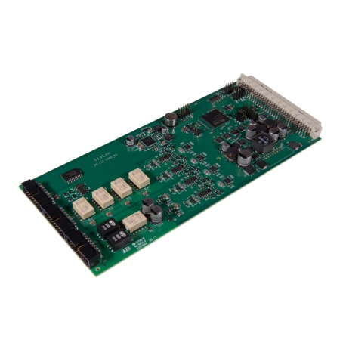
SeaCom product presentation

Slide 2
This presentation
Purpose of the SeaCom system Functionalities
Product line overview Exchanges Intercom stations Telephones Accessories
Exhanges SeaCom 3000 SeaCom 2100 SeaCom 19'' Circuit boards Accessories
Intercom stations and telephones General features SC411 SC421 SC211 SC220 SC325 Accessories
System programming
Miscellaneous
Manuals
Master/slave concept Cables Shielding Using the PIM of Classic

Slide 3
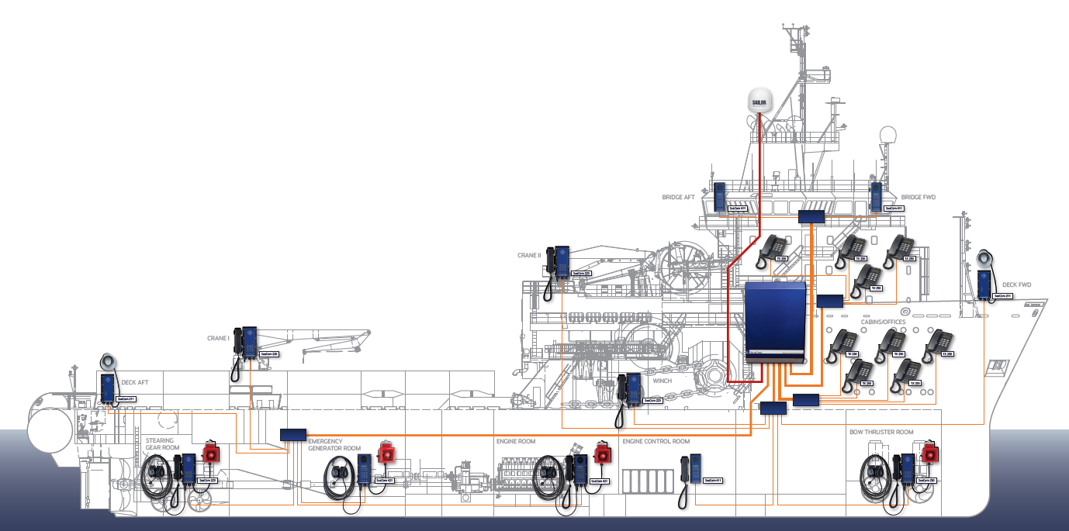
Purpose of the SeaCom system

Slide 4
Functionalities
Internal on board communication
Distribution of satellite communication
Communication in noisy environment
Communication in dirty, wet and salty environment
Telephone calls
Intercom style hands-free communication
Talk- back command calls
Groups and conference calls
Voice announcements (PA)
Time distribution and wake-up calls
Call Data Management

Slide 5
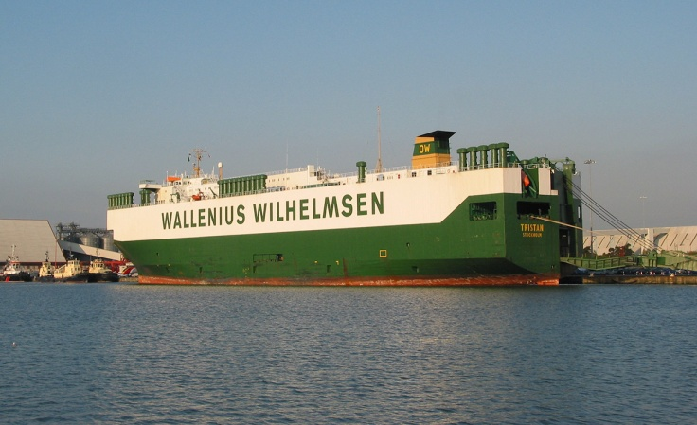
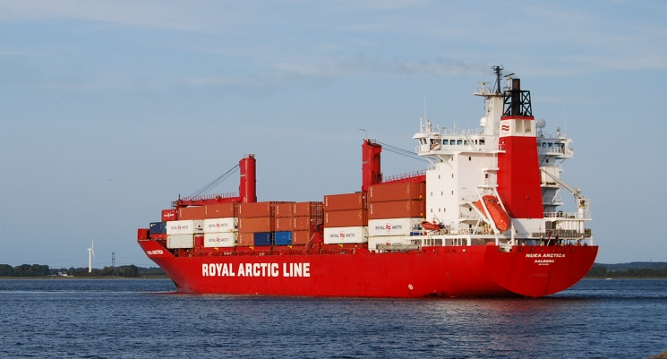
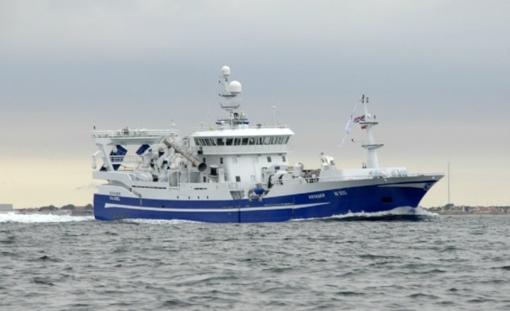
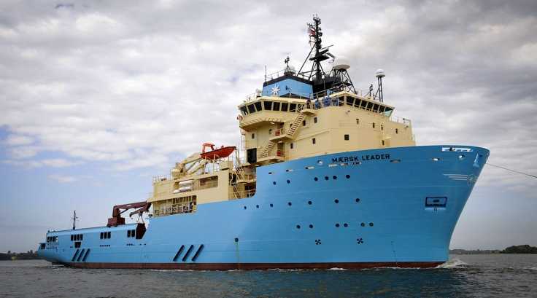
References

Slide 6
Product line overview
Exchange systems
SeaCom 3000
SeaCom 2100
SeaCom 19’’
Intercom stations and telephones
SC211
SC411
SC421
SC220
SC325
Accessories
Circuit boards
Accessories

Slide 7
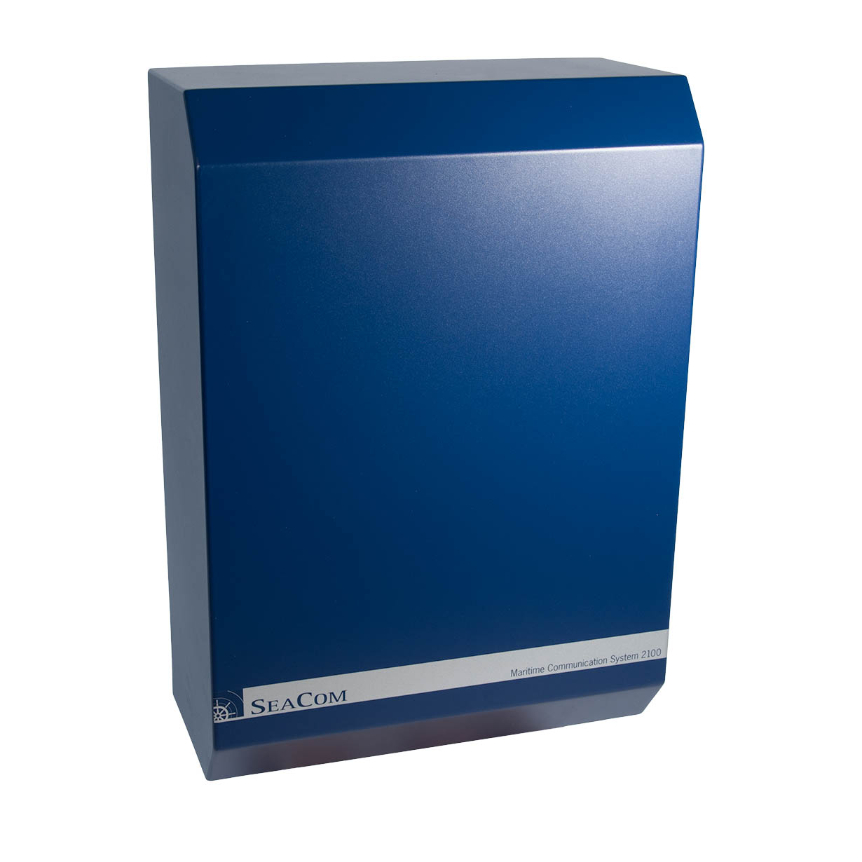
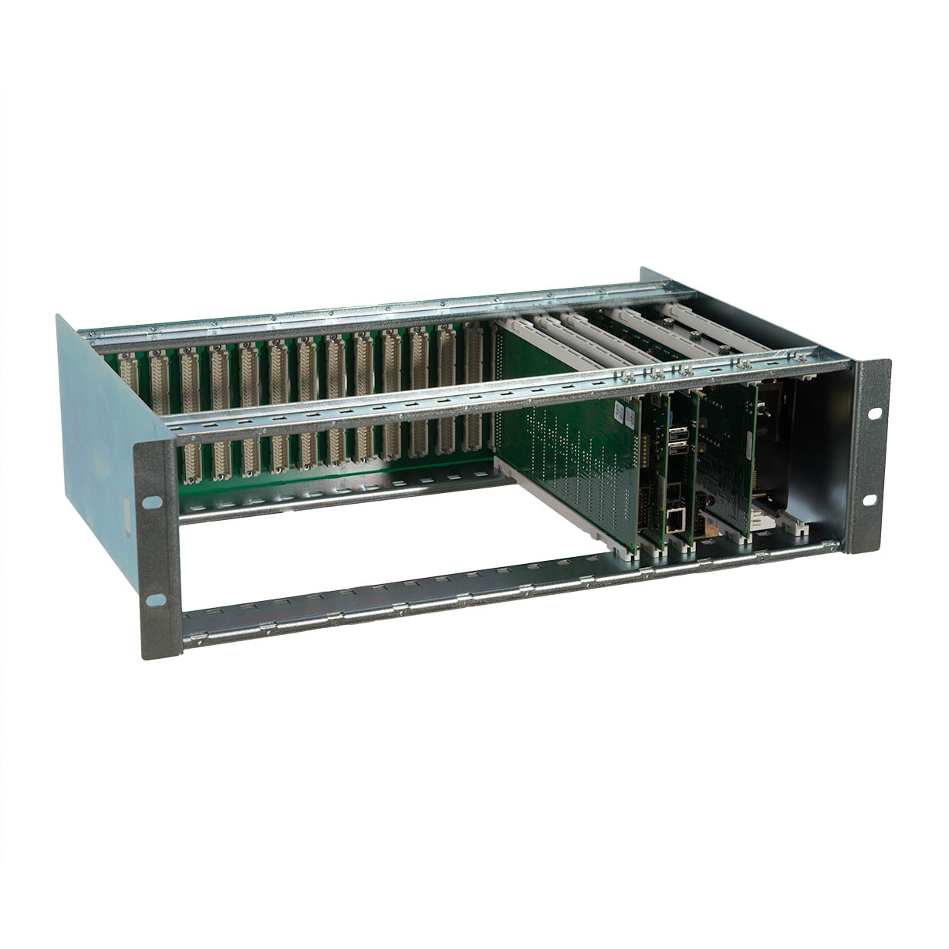
Exchanges
SeaCom 2100
SeaCom 3000
SeaCom 19’’

Slide 8
SeaCom 3000
Compact
Low cost
All cable terminations inside
24 extensions (extendable to 144)
2 trunk lines for satellite terminals
2 Audio out for PA
Alarm relay output for bridge alarm systems
Powered by 2 x 24V (main and battery)
Low power 6W (24 lines system)
0 - 55 dgs operating
Type approved by DNV-GL
All common features of telephone systems
Windows based configuration of number plan
LxBxH 372 x 179 x 505 mm

Slide 9
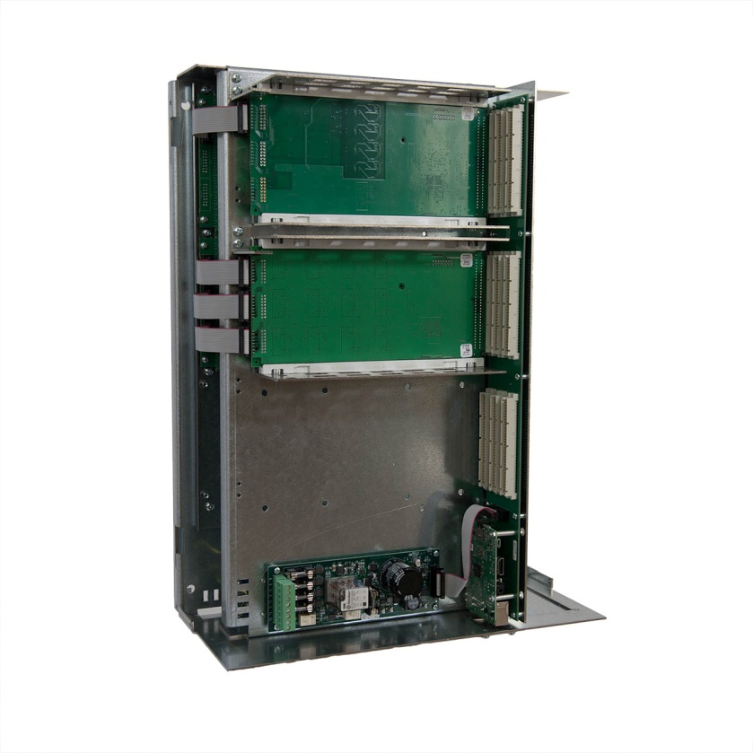
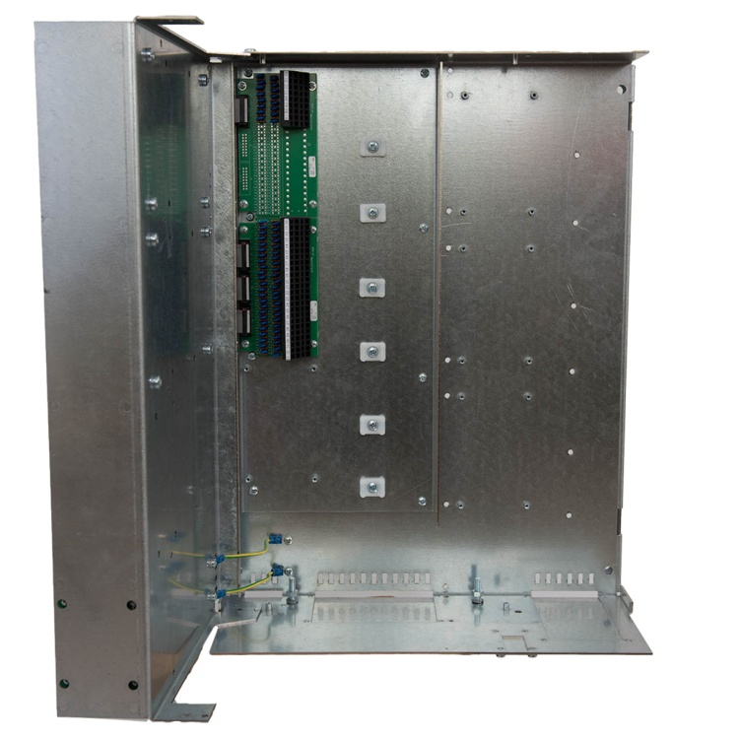
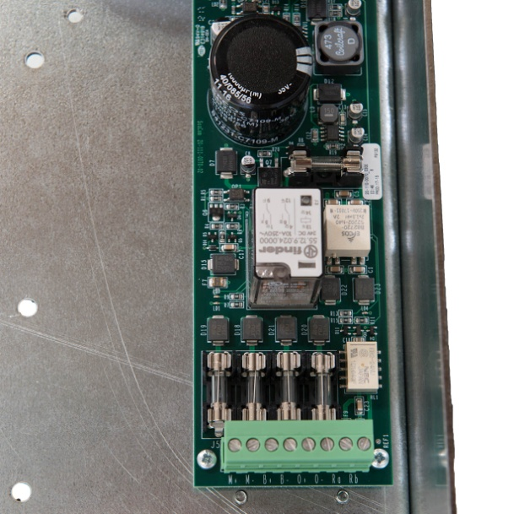
SeaCom 3000 inside

Slide 10
SeaCom 2100
Large steel cabinet
All cable terminations inside
8 extensions (extendable to 256)
2 trunk lines for satellite terminals
Alarm relay output for bridge alarm systems
Powered by 2 x 24V (main and battery)
Power consumption 15W (8 lines system)
0 - 55 dgs operating
Type approved by DNV-GL
All common features of telephone systems
Optional Call Data Management system
Windows based configuration of number plan
LxBxH 475 x 232 x 670 mm

Slide 11
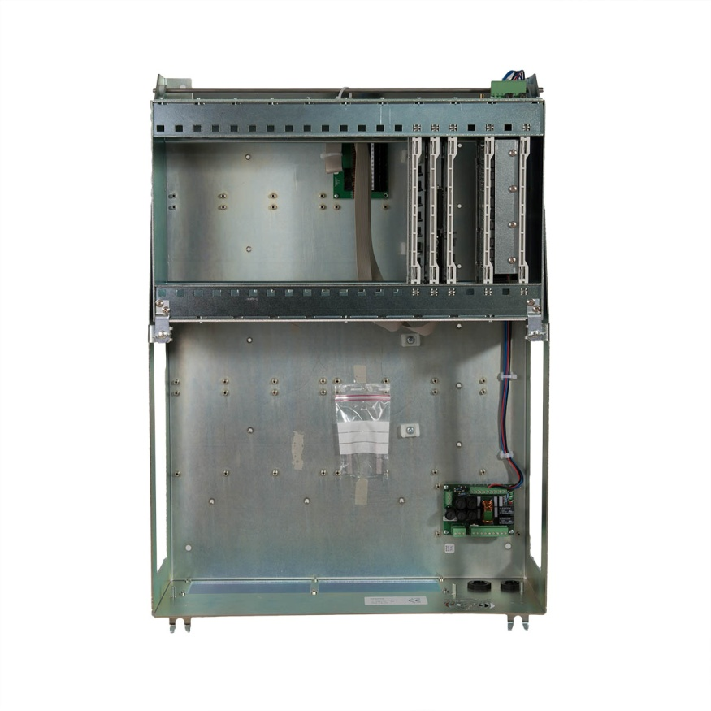
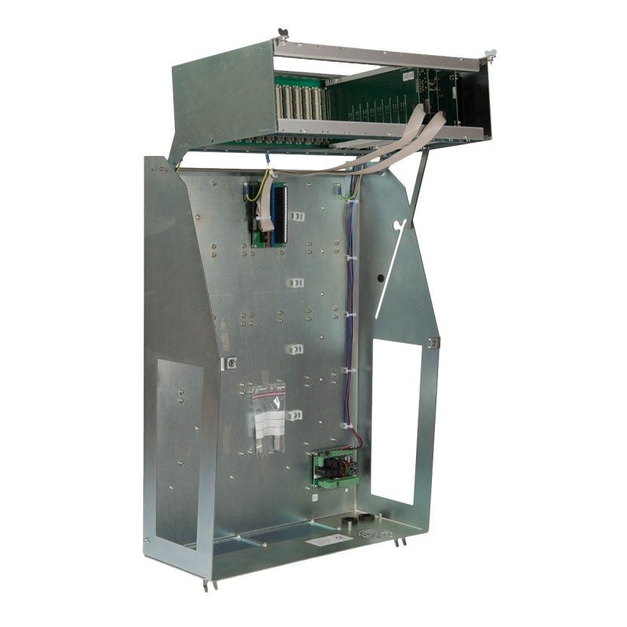
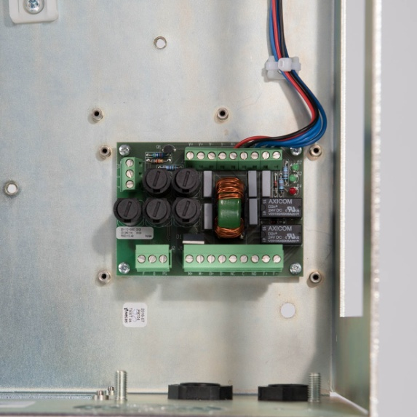
SeaCom 2100 inside

Slide 12
SeaCom 19’’
Building part for creating custom exchangers
18 board positions
Paralleling possible for up to 800 extensions
Powered by 1 x 24V
Power consumption 15W (8 lines system)
0 - 55 dgs operating
All common features of telephone systems
Windows based configuration of number plan
Optional Call Data Management
LxBxH 483 x 300 x 128 mm
Included are: PSU, CP2, FIO2M, AEXT8

Slide 13
Circuit boards for exchanges
AEXT16 Analogue Extension line card
AEXT8 Analogue Extension line card (DISCONTINUED)
FIO4 Trunk line and audio I/O card
FIO2 Trunk line and audio I/O card (DISCONTINUED)
CP2 Central Processor running Windows
LSP Linux System Processor running Linux
PSU2 Power Supply Unit for SeaCom 2100 and 19’’
CTU2 Cable Termination Unit 16+2 lines
CTU24 Cable Termination Unit 24 lines
PDU Power Distribution Unit
PIM Power Input Module for SeaCom 2100 and 19’’

Slide 14
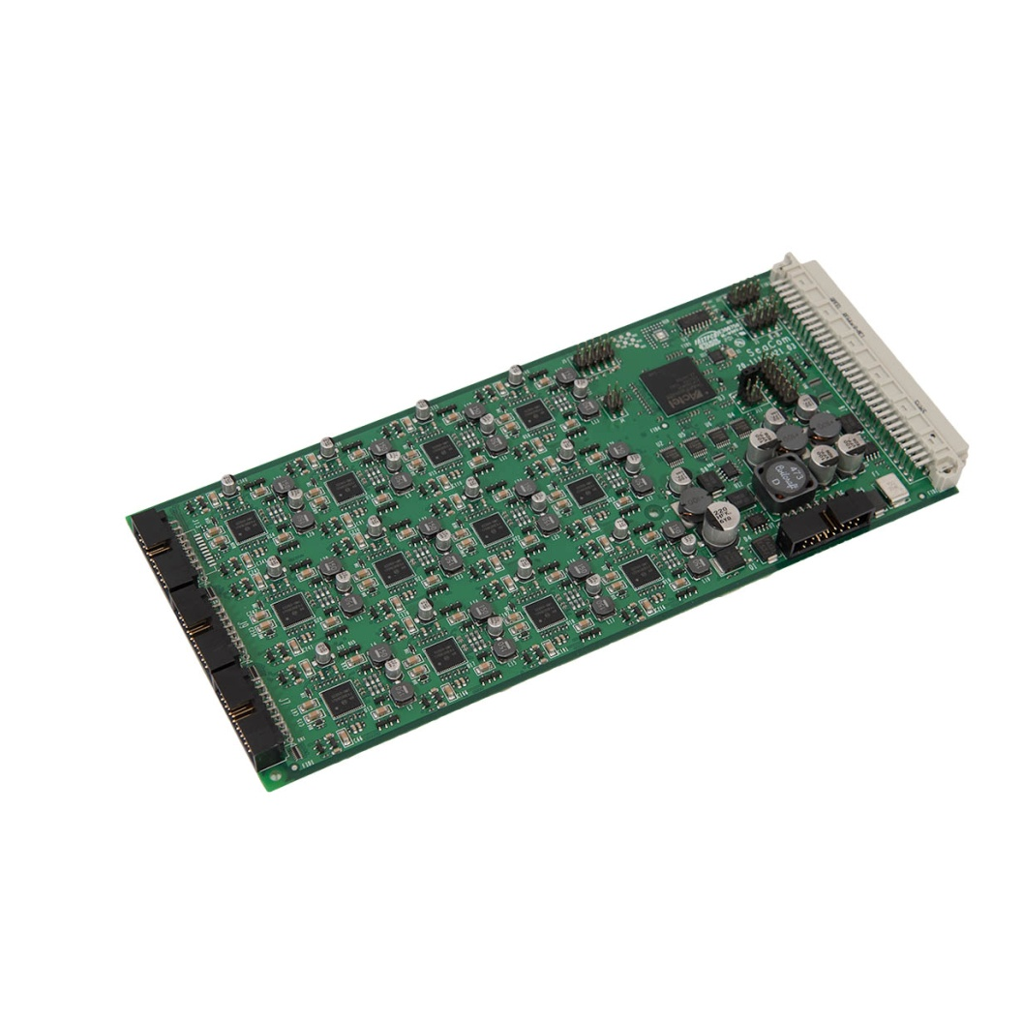
AEXT16
Analogue Extension Line card
To be used in all exchange systems
8, 16 or 24 channels
Plain old telephone line interfaces
48V DC line feed
20mA loop current
50V 50Hz ringing signal
DTMF tone dialing
Loop disconnect dial (rotary dial)
FSK caller ID signaling
16 kHz out of voice band signaling
Gong generator for PA calls
Alarm tone generator
Backplane bus master capabilities

Slide 15
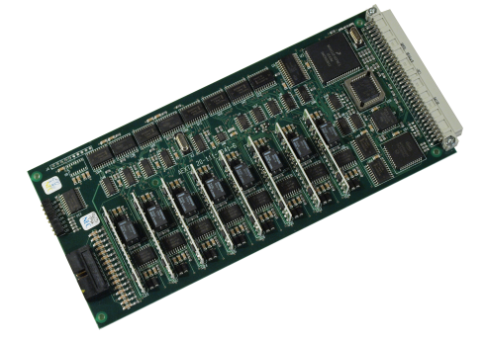
AEXT8
Analogue Extension Line card
To be used in SeaCom 2100 and SeaCom 19’’
8 channels
Plain old telephone line interfaces
48V DC line feed
20mA loop current
50V 50Hz ringing signal
DTMF tone dialing
Loop disconnect dial (rotary dial)
FSK caller ID signaling
16 kHz out of voice band signaling
Gong generator for PA calls
Alarm tone generator
DISCONTINUED but still on stock

Slide 16
FIO4
Flexible IO card 2 or 4 lines
To be used in all exchange systems
2, 4 trunk lines
2 audio in/out channels
2 relays associated with audio channels
2 general purpose relays
2 general purpose digital inputs
8 zone relay drive output (the 4 line only) driving ZRL8 PA speaker realy board
Line feed detection
Ringing detection
DTMF receiver
DTMF transmitter
Call progress tone detector
Galvanic isolated 1,5kV
Zone relay drive 24V 50mA
Backplane bus master capabilities
Conference voice adder

Slide 17
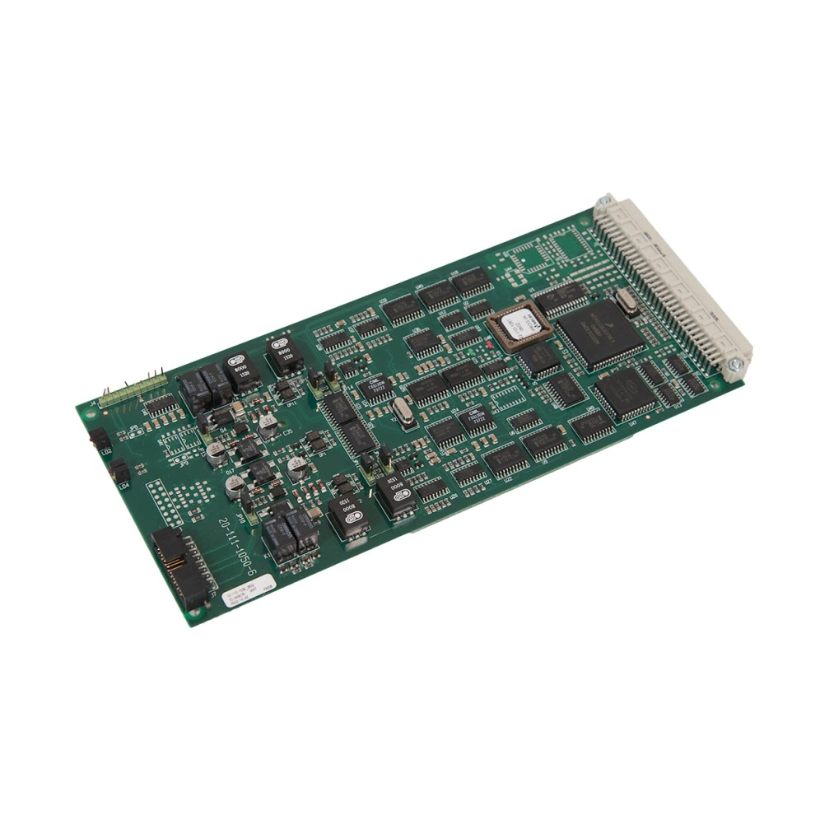
FIO2
Flexible IO card 2 lines
To be used in all exchange systems
Analogue trunk for satellite terminals
Audio in for music listening
Audio out for PA amplfiers
Line voltage and current detection
Ringing detection
DTMF receiver
DTMF transmitter
Call Progress Tone Detections
600 ohm audio in/out
600 ohm trunk line impedance
Realy contact 24V DC 1A
Galvanic isolation
DISCONTINUED but still on stock

Slide 18
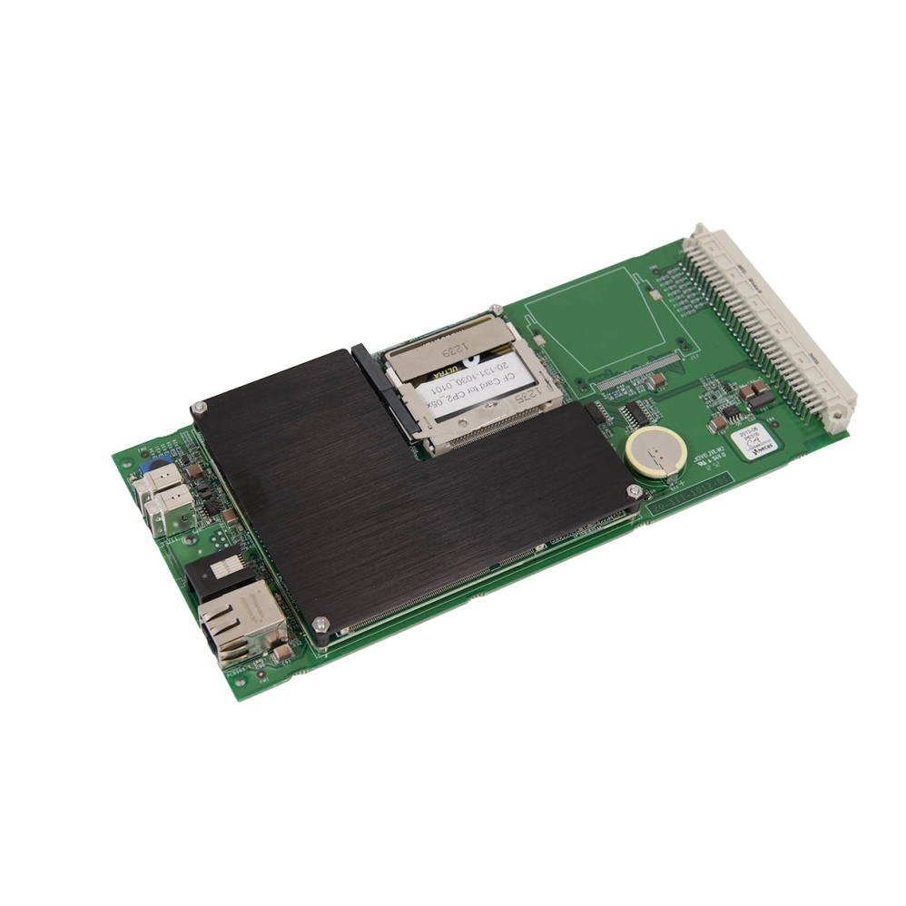
CP2
CP processor board
To be used in AlphaConnect 128 and 19’’
Executing the Mxproces.exe software
Holding the mx.mcf configuration file
AMD G-series processor
1000 Mb RAM
Disk 8Gb Compact flash
10/100 Mbit Ethernet
2 USB Serial port
1 RS232 serial port
Power 5W
DHCP server
Remote desktop server
Capable of running Call Data Manager

Slide 19
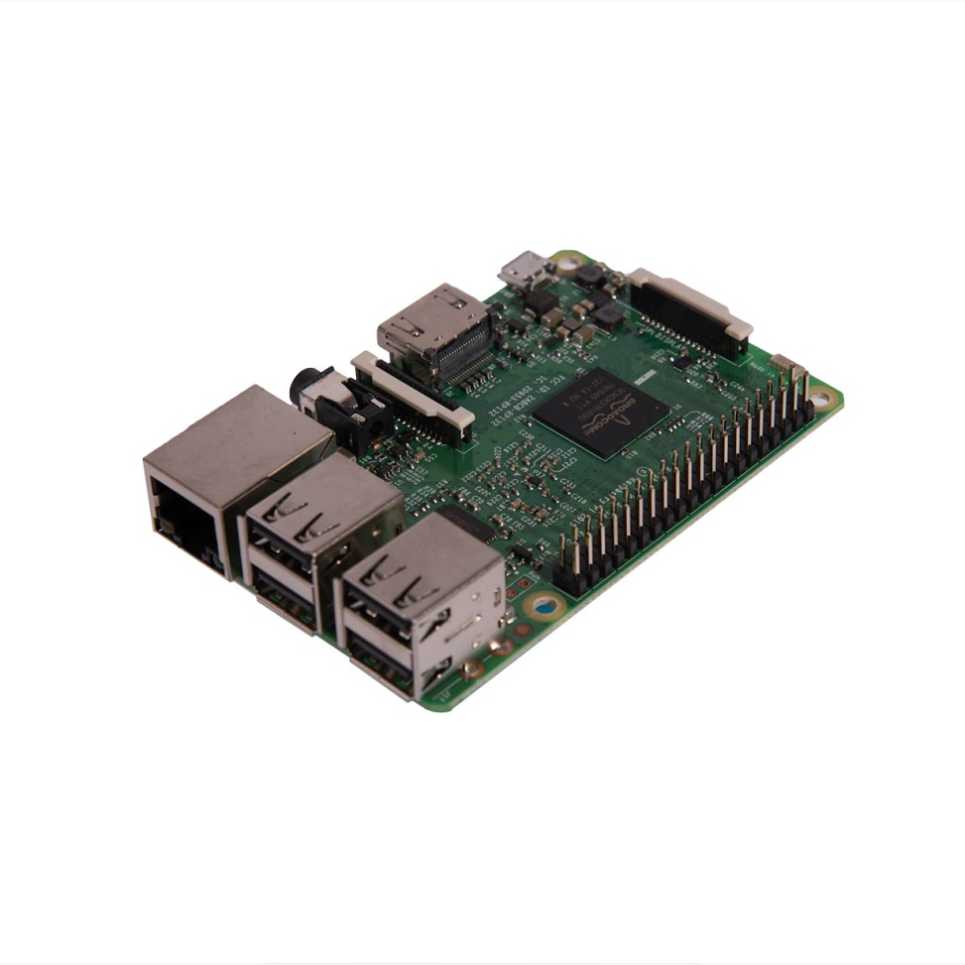
LSP
Linux System Processor
Used in AlphaConnect Classic only
Running customized Linux OS system
Executing the Processor software
Holding the configuration_file
64 bit quad-core ARM Cortext-A53
1.2GHz processor speed
DRAM 1GByte
16GByte Industrial grade SD card with
Ethernet interface
DHCP server
USB interface
Industrial temperature range -25 ~ + 70 °C

Slide 20
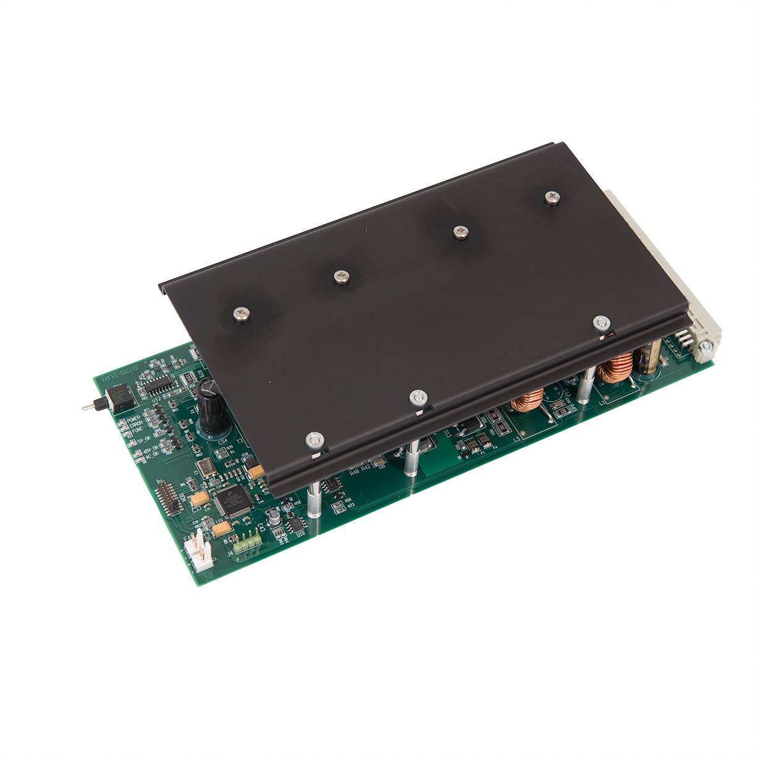
PSU2
Power Supply Unit
Used in AlphaConnect 128 and 19´´ only
Required for using CP2 and AEXT8
Converts 24V DC power supply into: -48V DC, +-5V DC 80V 50 Hz AC.
On/off switch
Power indicators
System watch dog
250W total

Slide 21
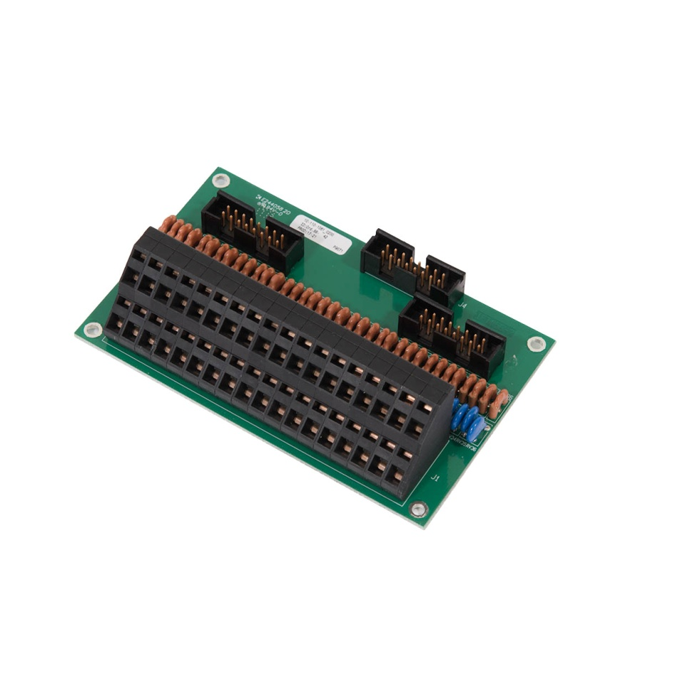
CTU2
Cable Termination Unit
16 + 2 lines
Max 1,5mm2
Max current 1A

Slide 22
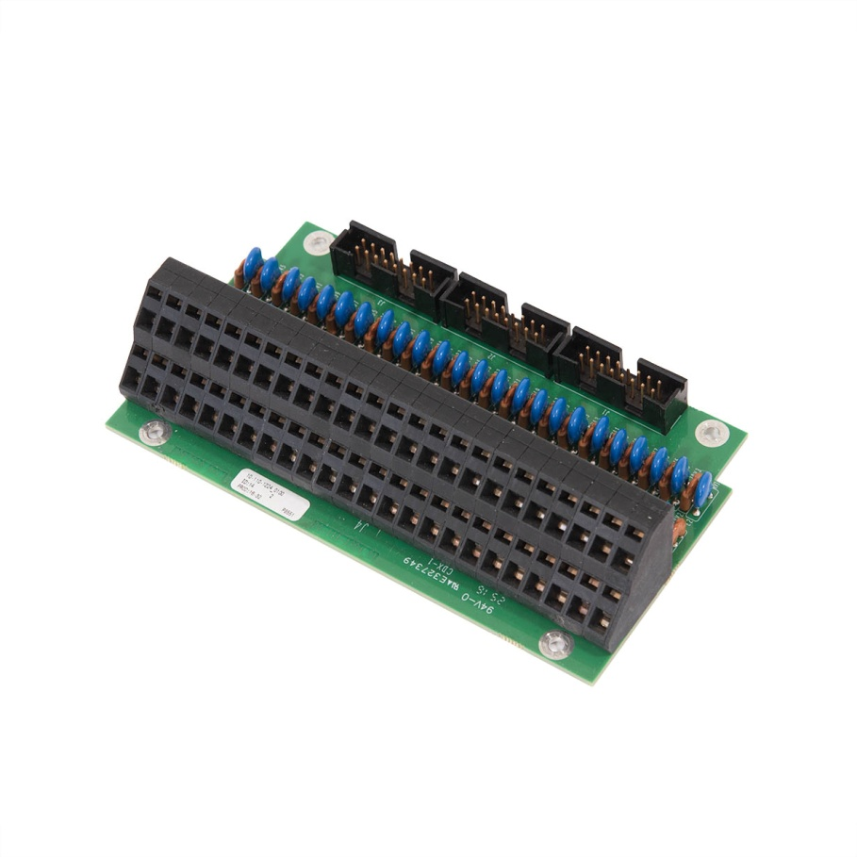
CTU24
Cable Termination Unit
24 lines
Max 1,5mm2
Max current 1A

Slide 23
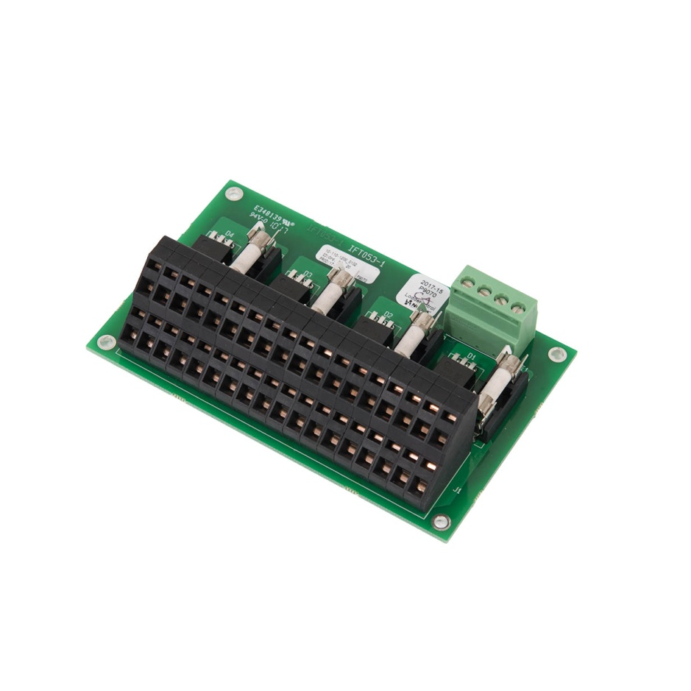
PDU
Power Distribution Unit
24V DC operation only
Input max 10A
18 power outputs
Output max 1A
4 fused groups
2 inputs: main and battery
Build in summing diodes

Slide 24
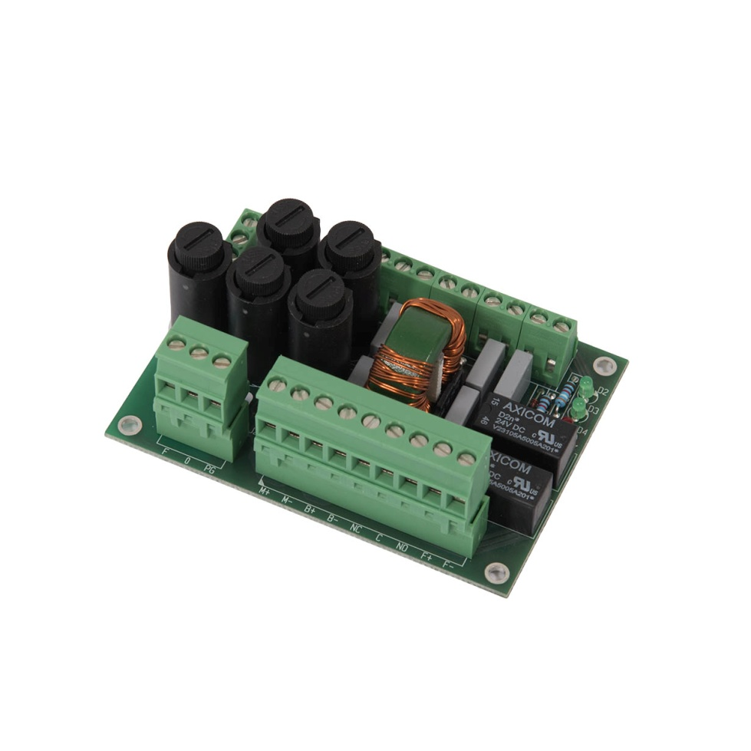
PIM
Power Input Module
Used in AlphaConnect 128 and 19’’
24V DC operation only
Max 4A
Two power inputs: main and battery
Internal summing diode
Alarm relay output
Fan drive output
Power indicator LED's
Alarm indicator LED

Slide 25
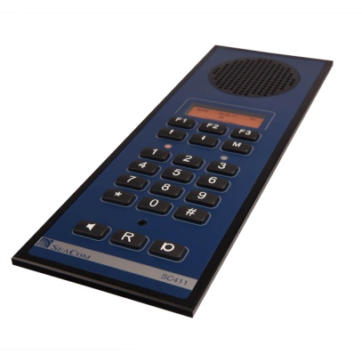
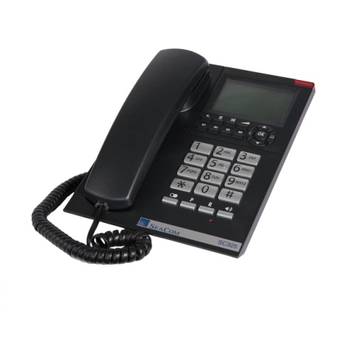
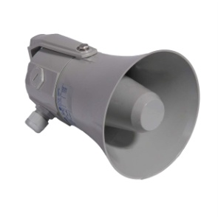
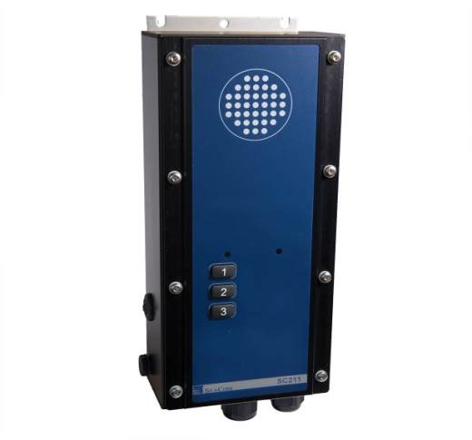
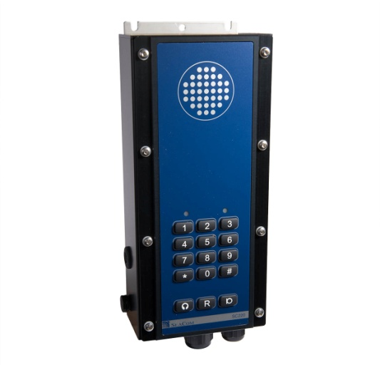
Intercom stations and telephones
SC411
Bridge , ECR
SC325 Cabins, offices
SC211 Deck,
engine
SC220 General purpose industrial telephone
SC421 Deck, engine, workshop, galley

Slide 26
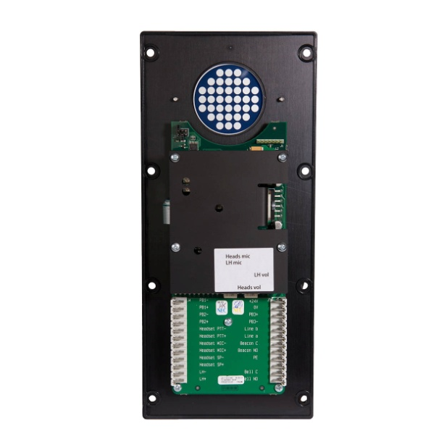
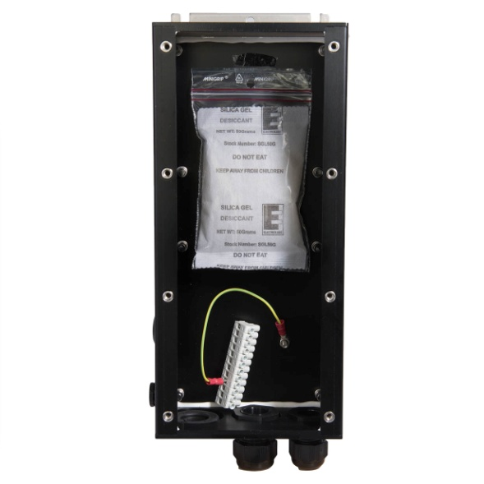
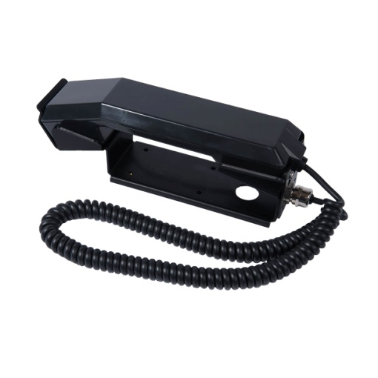
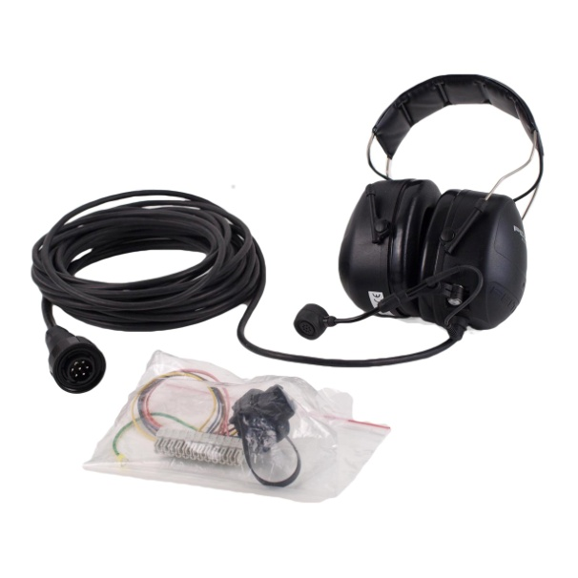
General concepts
Shared box layout
Shared layout of the connectors
Shared headset
Shared handset

Slide 27
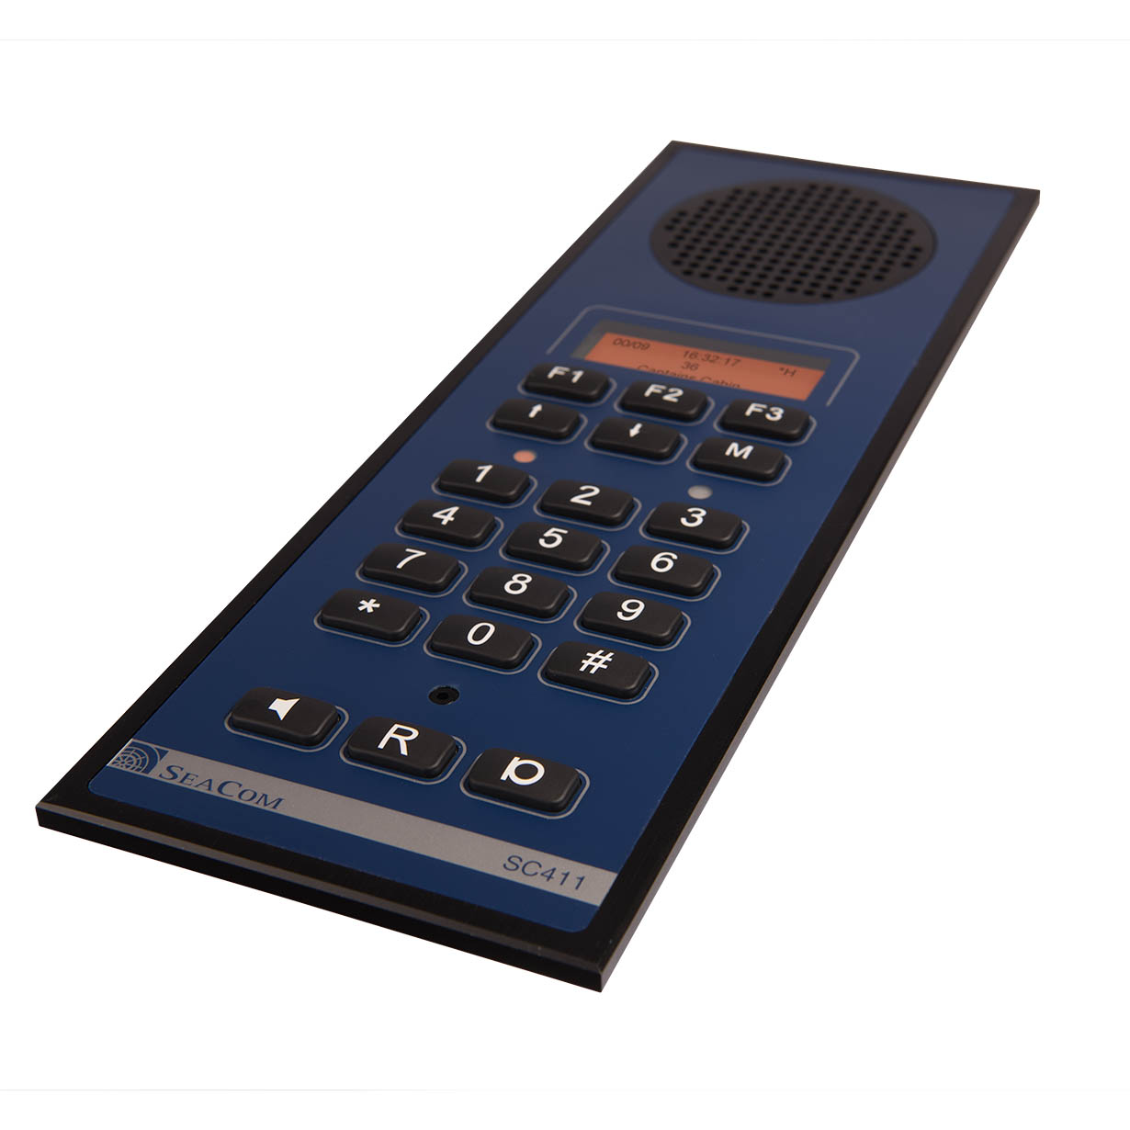
SC411
To be used on bridge console and ECR
Screw less flush mount
Loud speaking hands-free
Auto dimmed red backlight
Connects handset,
Connects headset
Connects 10W external speaker
Connects external microphone and footswitch
4 ringing sounds
Voice activated hook off
Busy tone disconnect
Power 18-32V DC 1A
Standard analog telephone line 600 ohm
DTMF & LD dialing
Ringing relay contacts 24V DC 1A.
-25 to 70 ºC operation
IP20
DNV-GL type approved
EN60945 and IACS E10 compliant

Slide 28
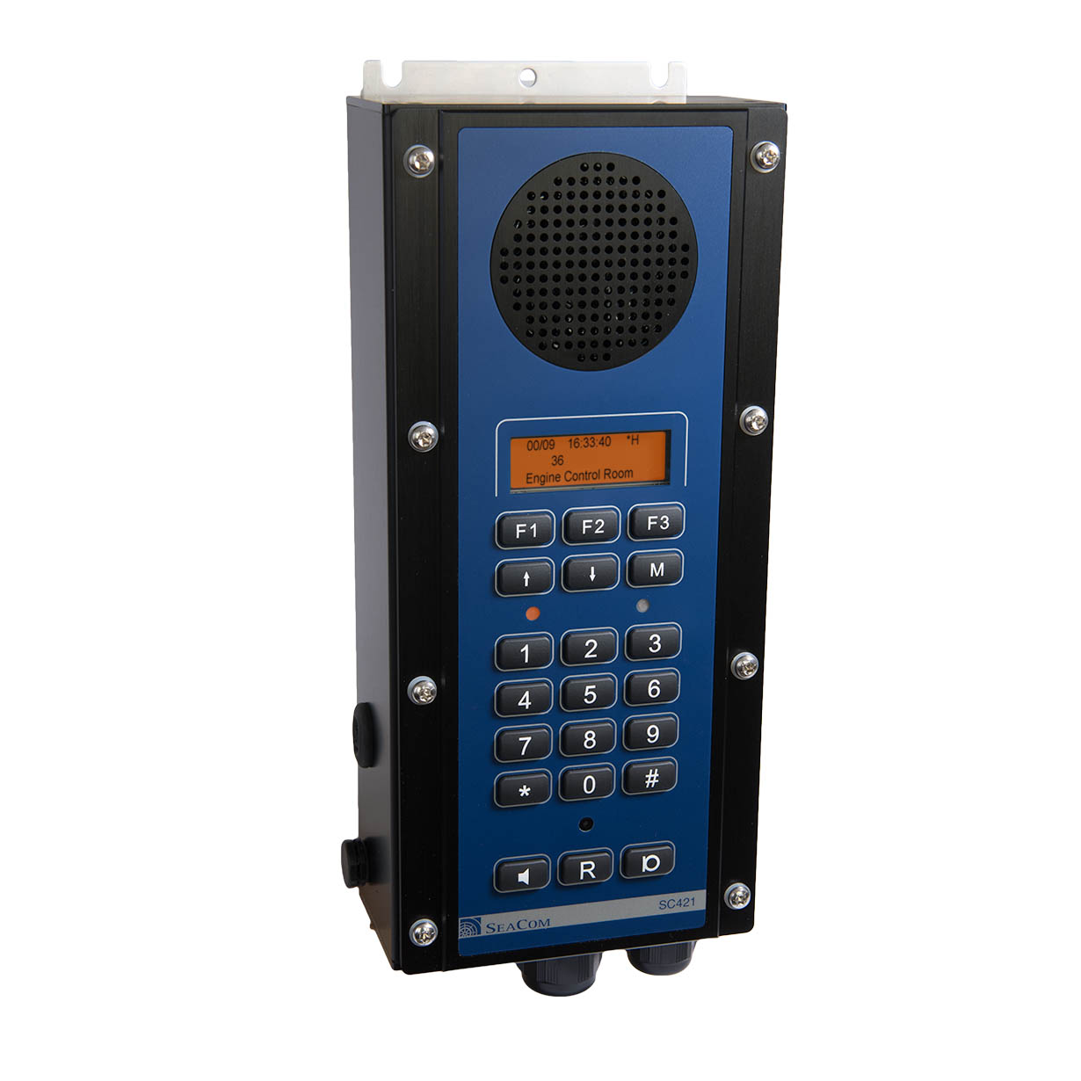
SC421
General purpose intercom station
Water tight
Salt mist resistant
Bulkhead mount
Loud speaking hands-free
Connects handset,
Connects headset
Connects 10W external speaker
Auto dimmed red backlight
Busy tone disconnect
4 ringing sounds
Power 18-32V DC 1A
Voice activated hook off
Line voltage 20-50V DC
Ringing 40-90Vrms @20-50Hz
Standard analog telephone line 600 ohm
DTMF & LD dialing
Ringing relay contacts 24V DC 1A.
-25 to 70 ºC operation
DNV-GL type approved
EN60945 and IACS E10 compliant

Slide 29
SC220
General purpose industrial telephone
Water tight
Salt mist resistant
Connects handset
Connects headset
2 wire analogue telephone
DTMF dialing
50V AC ringing
600 ohm line impedance
Relay for driving external flash / horn
Full numeric keyboard with R function
Headset button for headset only
MIC button for PTT mode with handset
Busy tone disconnect function
Programmable gain and volume
Type approved by DNV-GL

Slide 30
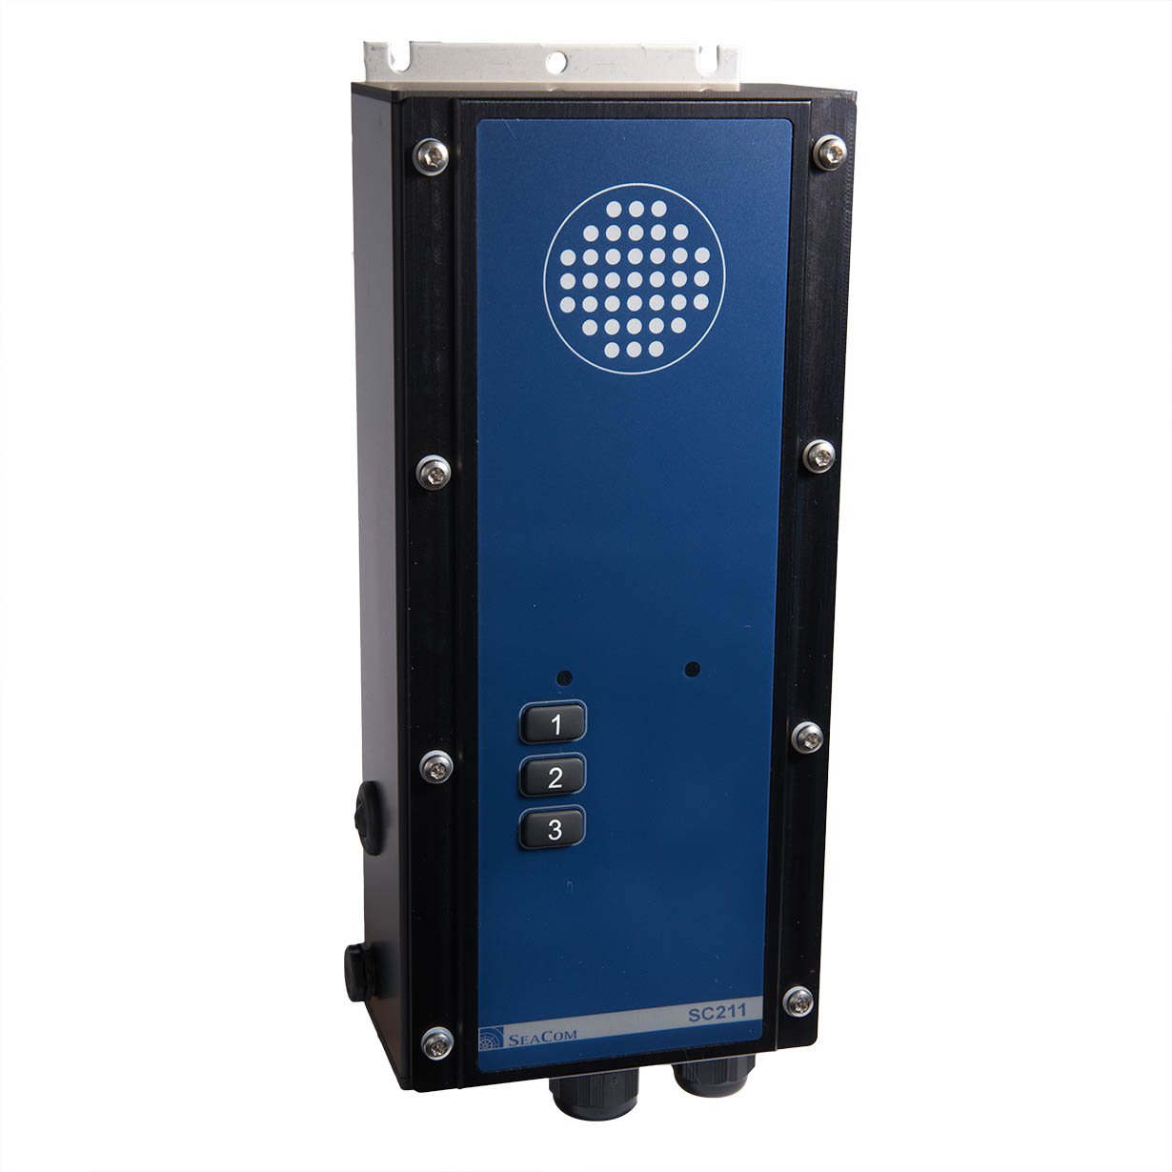
SC211
Talk back command station
To be used on deck and in engine spaces
Power 18-32V DC 1A
Connects headset
Connects 10W horn speaker
3 call buttons for fixed number calls and PTT
Relay for driving external flash / horn
10W speaker driver amplifier
Water tight enclosure
Internal adjustable volume setting
Internal microphone gain setting
Type approved by DNV-GL

Slide 31
TX325 / SC325
Telephone for cabins and offices
Desktop and wall mount
Powered by phone line only. NO batteries
Hands free speaking
Talk Large display showing
Caller ID and caller number
Time display
PA calls reception (D option)
Direct in calls (D option)
Clip for handset hold (D option)
2 wire interfacing
DTMF dialing
50V AC ringing
R button for transfers
RJ11 cable connection

Slide 32
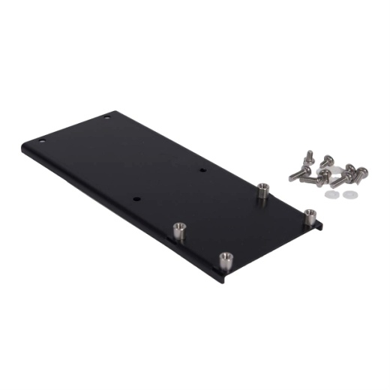
Accessories for intercom stations
Handset for SC220, SC421
Handset flush mount for SC411
Mounting kit

Slide 33
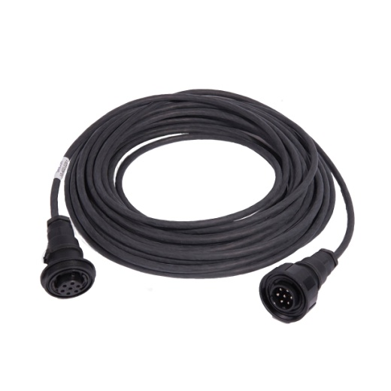
Accessories for intercom stations
Headset
Peltor based
Noise cancelling microphone
Heavy duty ”boot resistant” cable
Oil resistant cable
PTT switch on earcup
Headset extension cable
10 or 20m

Slide 34
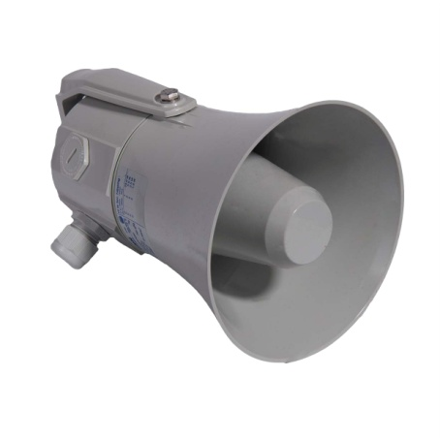
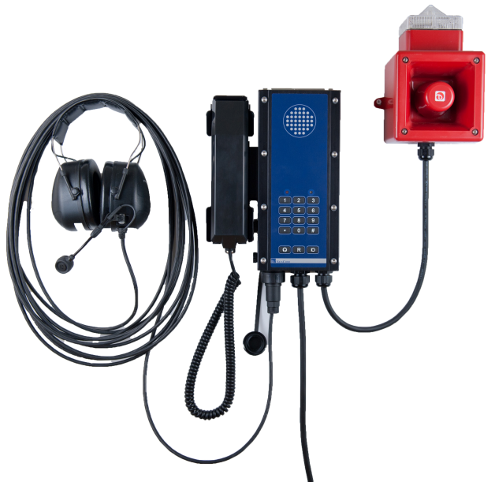
Accessories for intercom stations
Hornspeaker 10W 8ohm
SC211, SC421
Beacon sounder
SC211, SC220, SC421
24V DC
Activated by internal relay

Slide 35
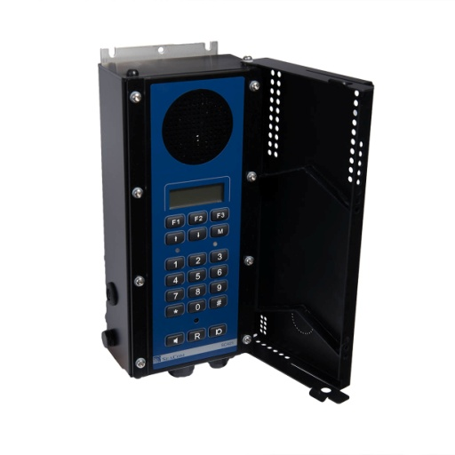
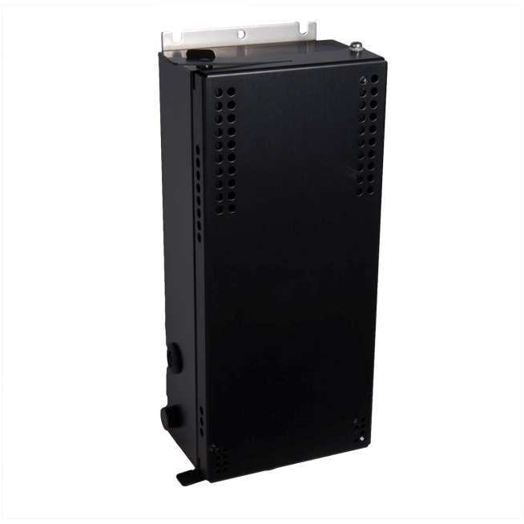
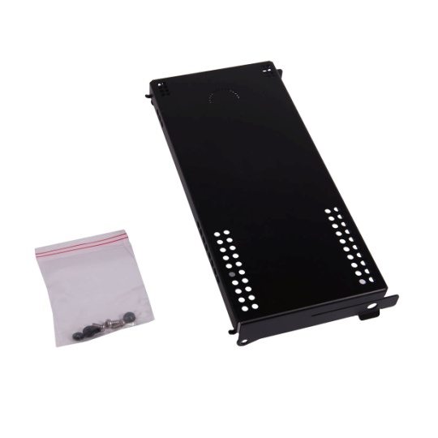
Accessories for intercom stations
Front cover door
IP65
SC211, SC220, SC421
Accoustically open

Slide 36
System programming
Windows based configuration tool software
One single file holding all data
Assigning telephone numbers
Assigning names of telephones
Defining system call numbers
Setting access privileges

Slide 37
Accessing the configuration file
Configuration data
The configuration file data are stored in one single file on the disk of the CP in use.
For the Windows OS, the file is named mx.mcf
For the Linux OS, the file is named configuration_file
Access to the file
USB key access.
Shared network folder access
Using remote desktop VNCviewer
Editing the file
Windows OS : use the Mxconfig.exe software tool
Linux OS : use the Configuration software tool

Slide 38
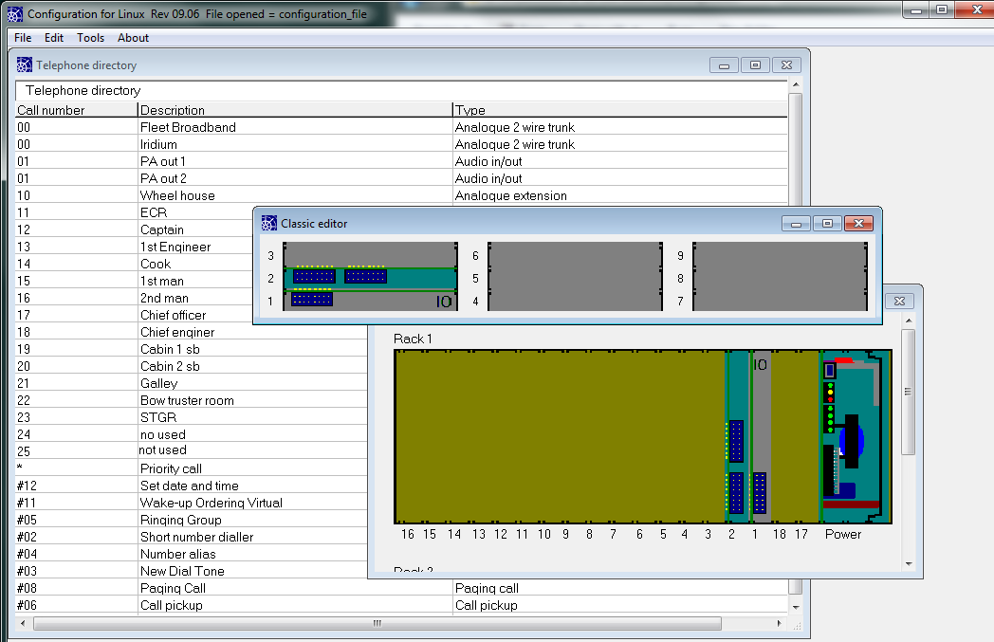
Basic views of the configuration tool

Slide 39
System call numbers
System call numbers are “virtual” call number having no hardware associated. They are used to implement system functions.
The below system call numbers are available:
Priority call
Set date and time
Wake up
Ringing group
Short number dial
Number alias
Paging call
Call pickup
Music when free
Alarm distribution
Mode selection (day mode / night mode)
Do not disturb
Semi-duplex conference (talk back)
Real conference

Slide 40
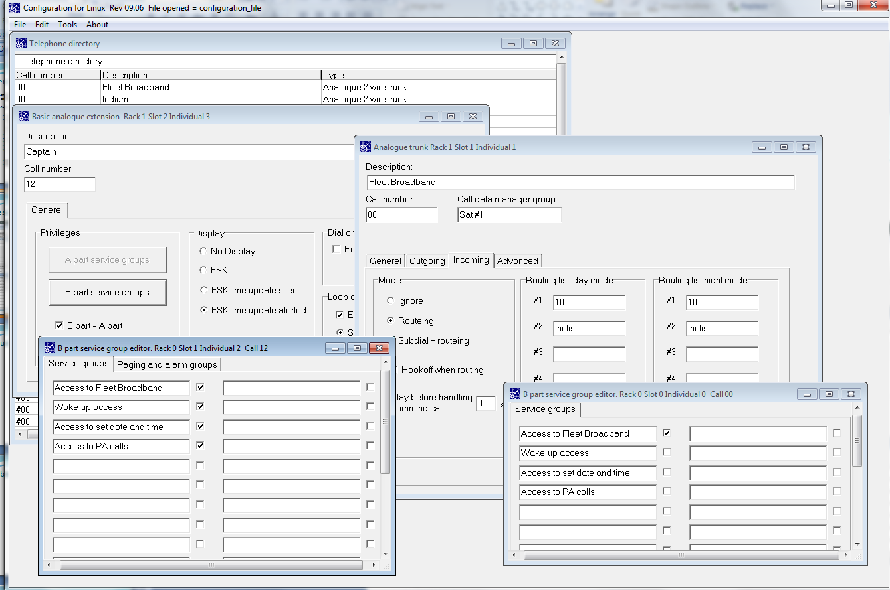
Access control

Slide 41
Miscellaneous good to know
Manuals and MAN pages
The master slave concept
Cables
Shielding
PIM of the Classic

Slide 42
Manuals and MAN pages
SeaCom 3000 User Manual Covering the SeaCom 3000 and all stations and system programming
SeaCom System Manual Covering the SeaCom 2100, SeaCom 19’’ and all stations and system programming
MAN pages Short form manual for selected products

Slide 43
Cables
Always use twisted pair shielded
SC325, SC325 and SC220
Minimum 0.25mm² length of cable. max. 1800m
SC411 and SC421 with internal speaker only
1 mm² per 600m lentgth of cable. max. 1800m
SC211, SC411 and SC421 with external 10W speaker in use
1 mm² per 200m length of cable. max. 1800m

Slide 44
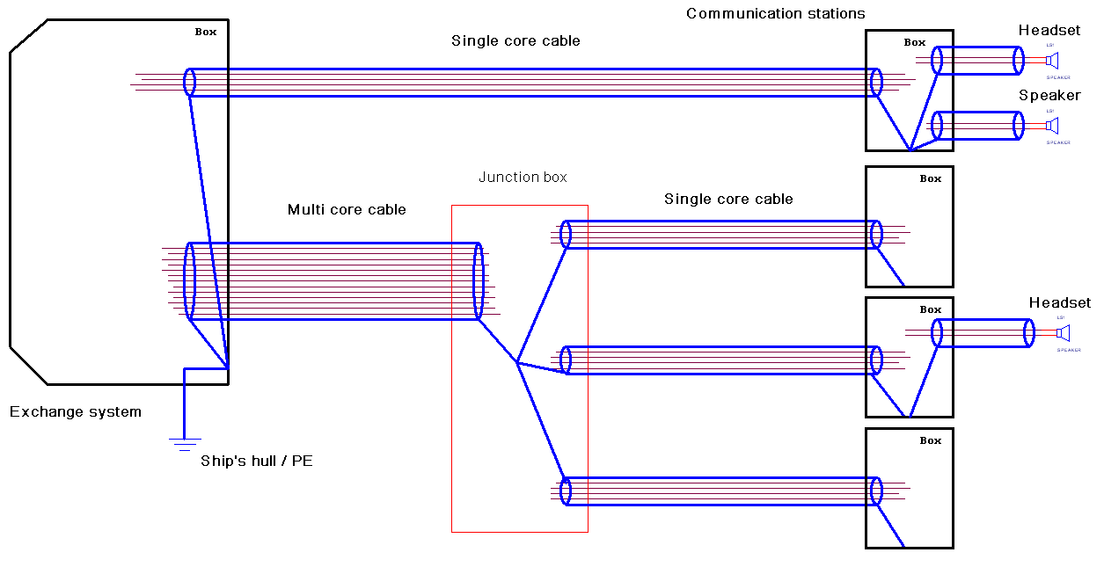
Shielding

Slide 45
Using PIM of the SeaColm 3000

Slide 46
Thanks for watching the presentation

